Slide 1
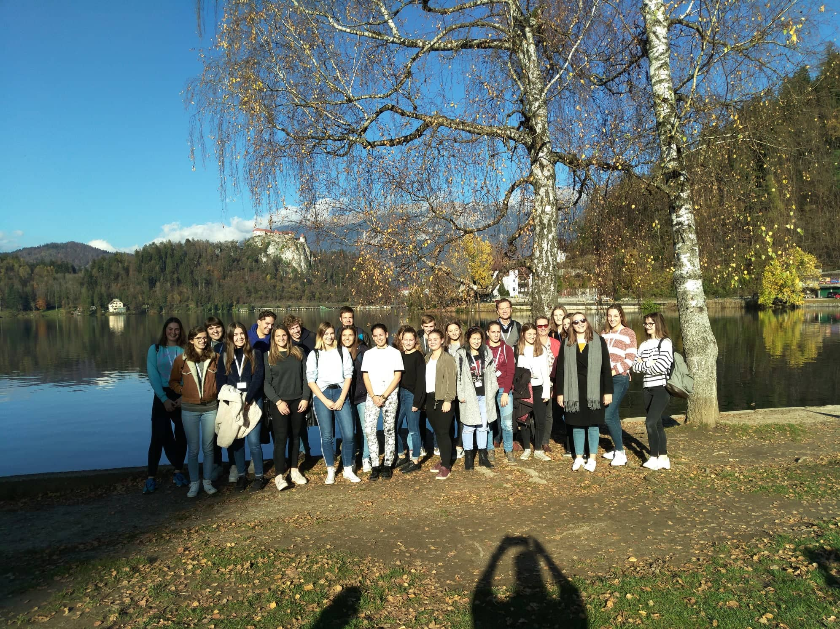
SKILLS4LIFE
11.11.2018 – 17.11.2018

Slide 2
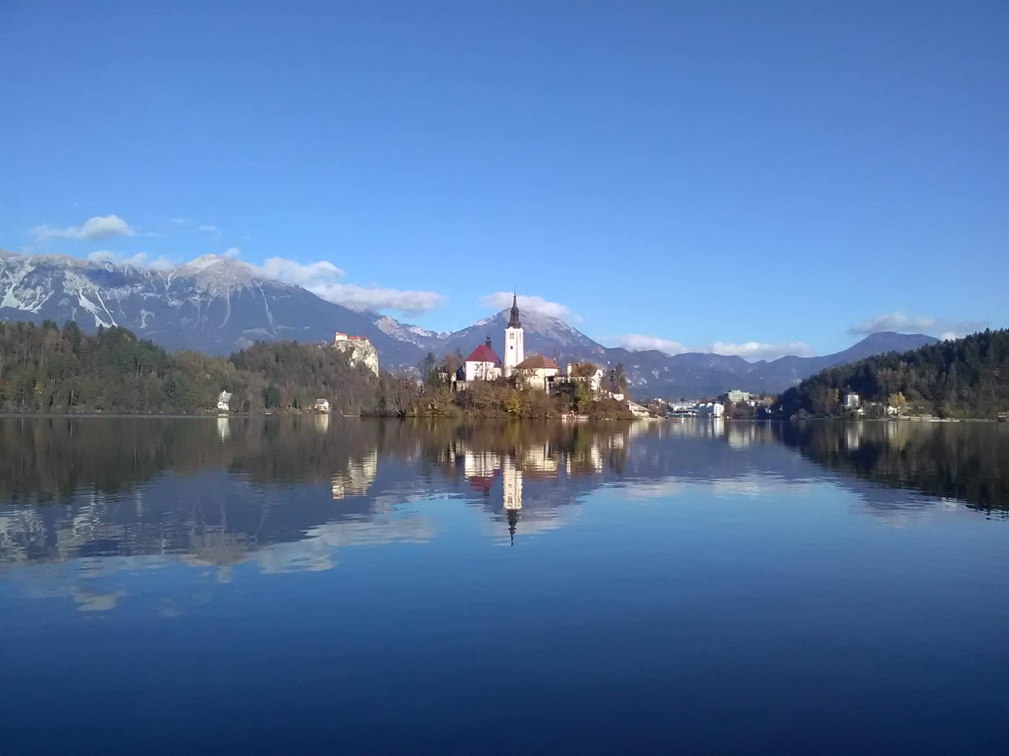
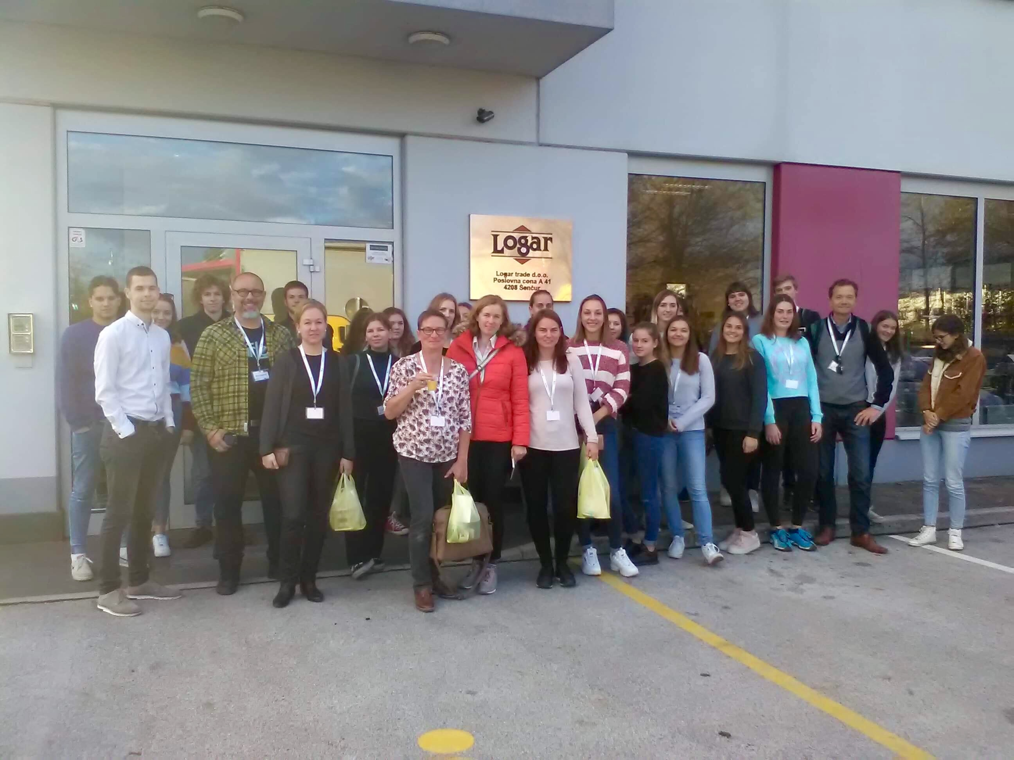
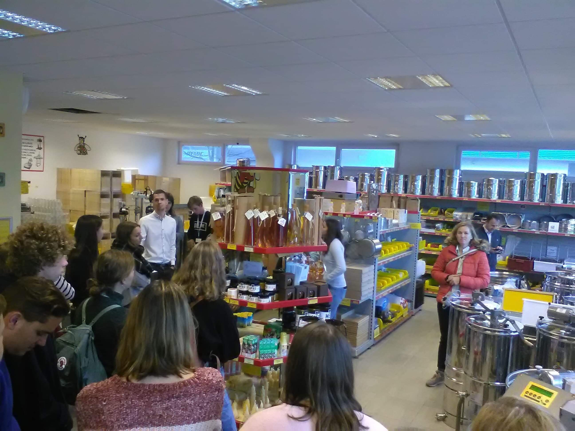
MONDAY
We went to the Honey Museum in Radovljica where we learned a lot of new things about bees. We also visited the lake Bled and small family company Logar trade.

Slide 3
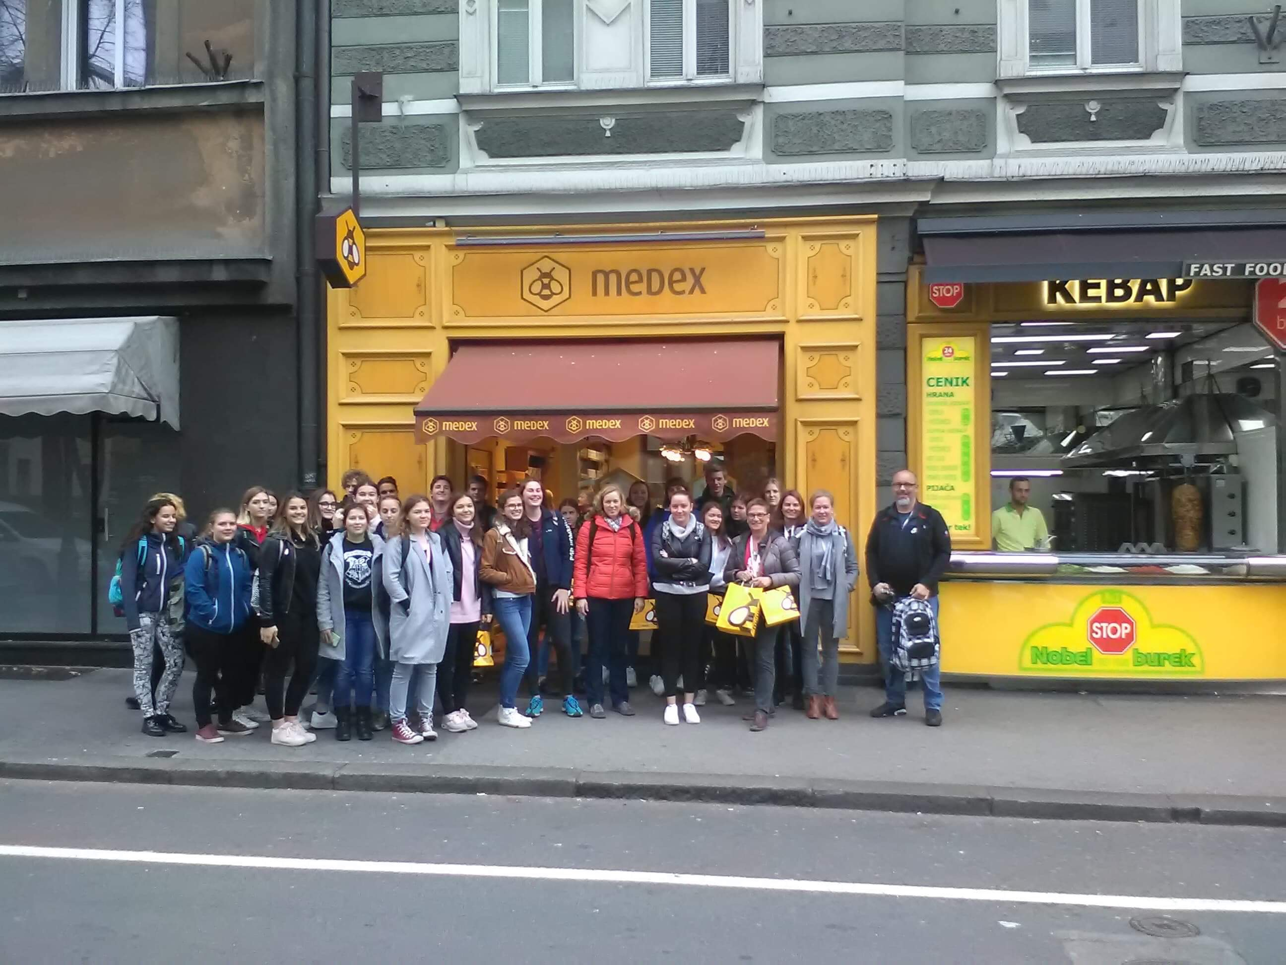
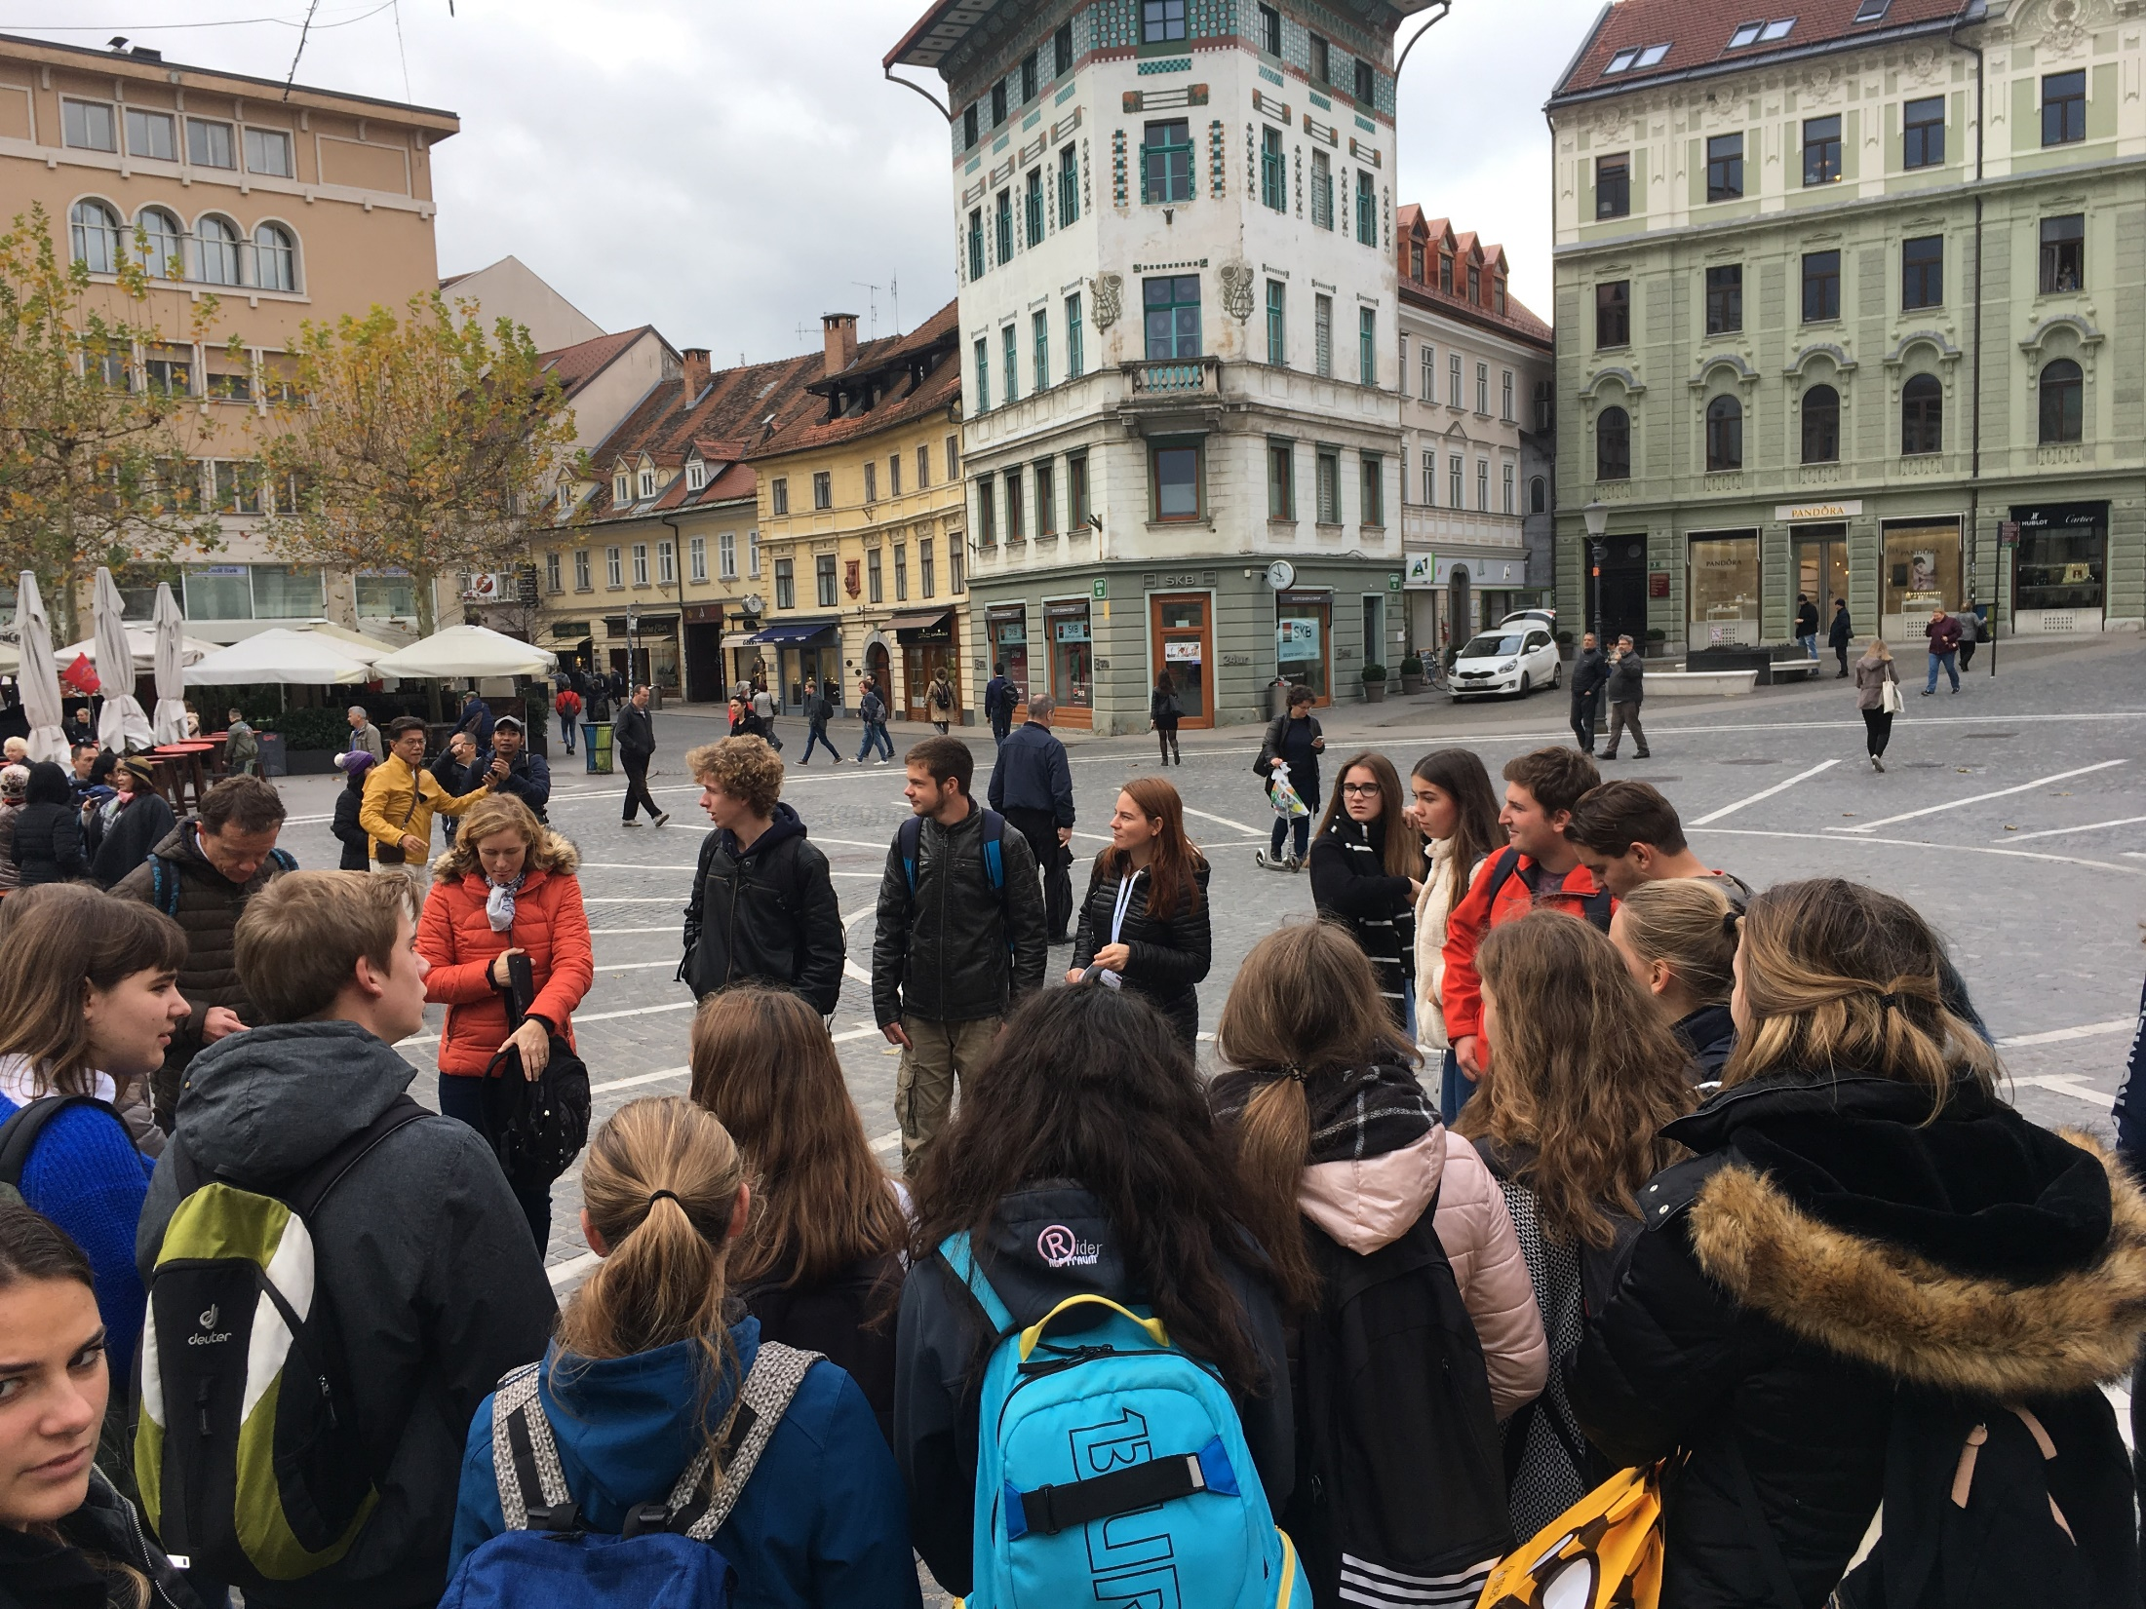
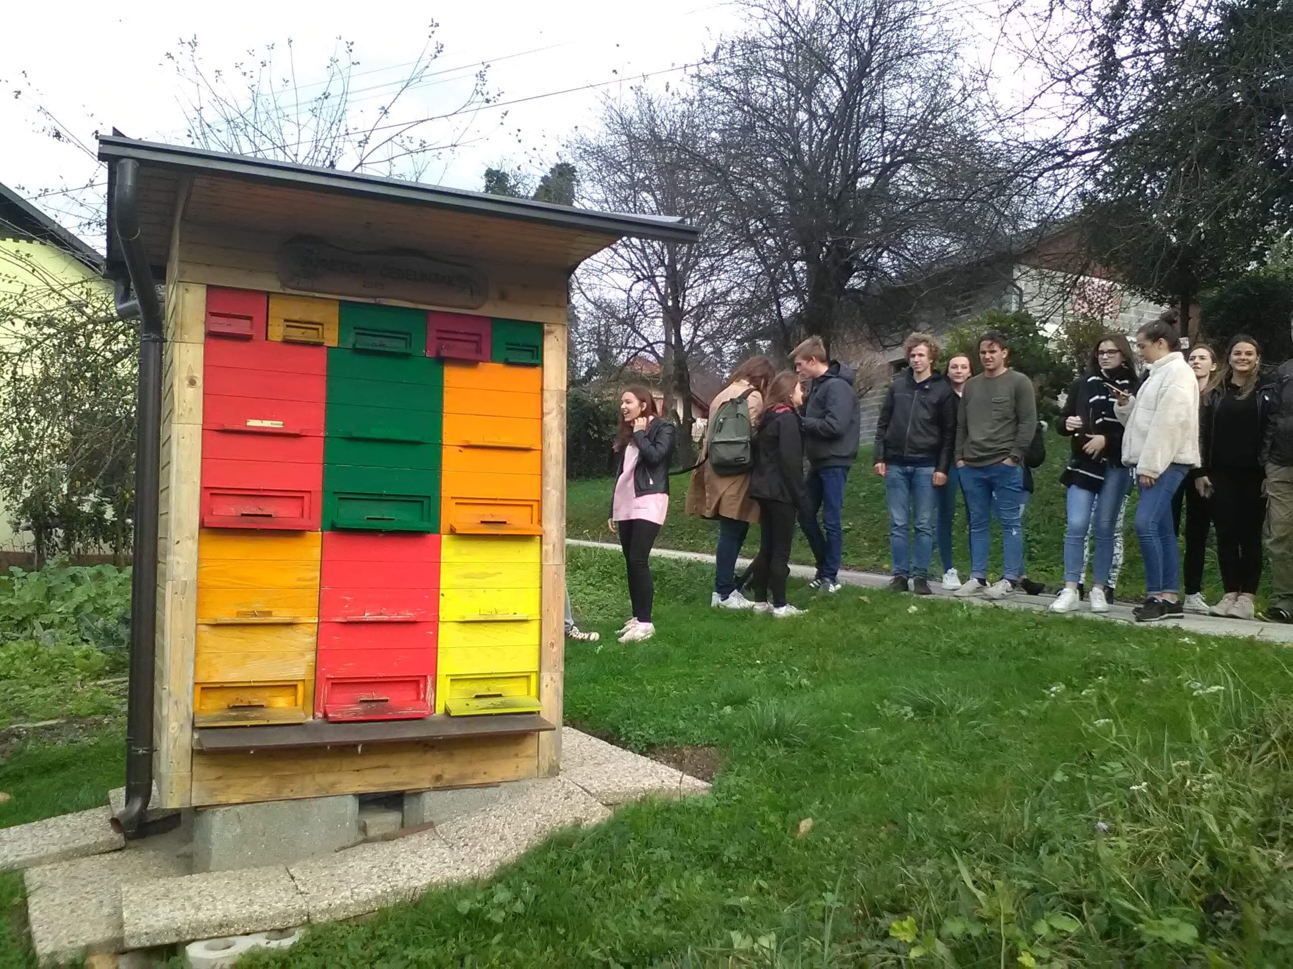
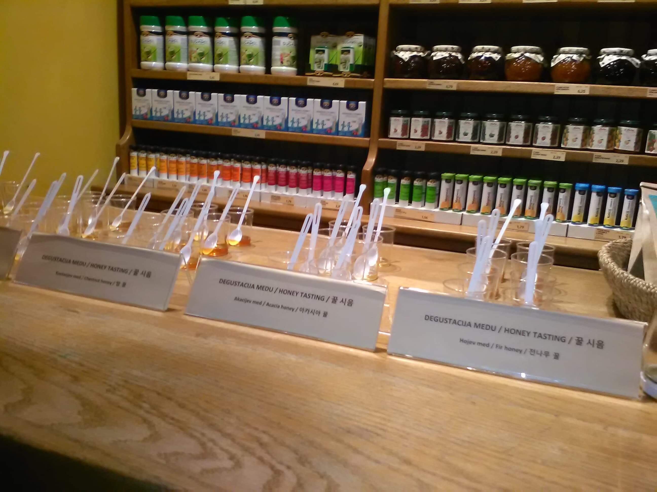
TUESDAY
We saw the capital city of Slovenia, Ljubljana. There we went to a company called Medex and then an ex-student showed us his homemade honey production

Slide 4
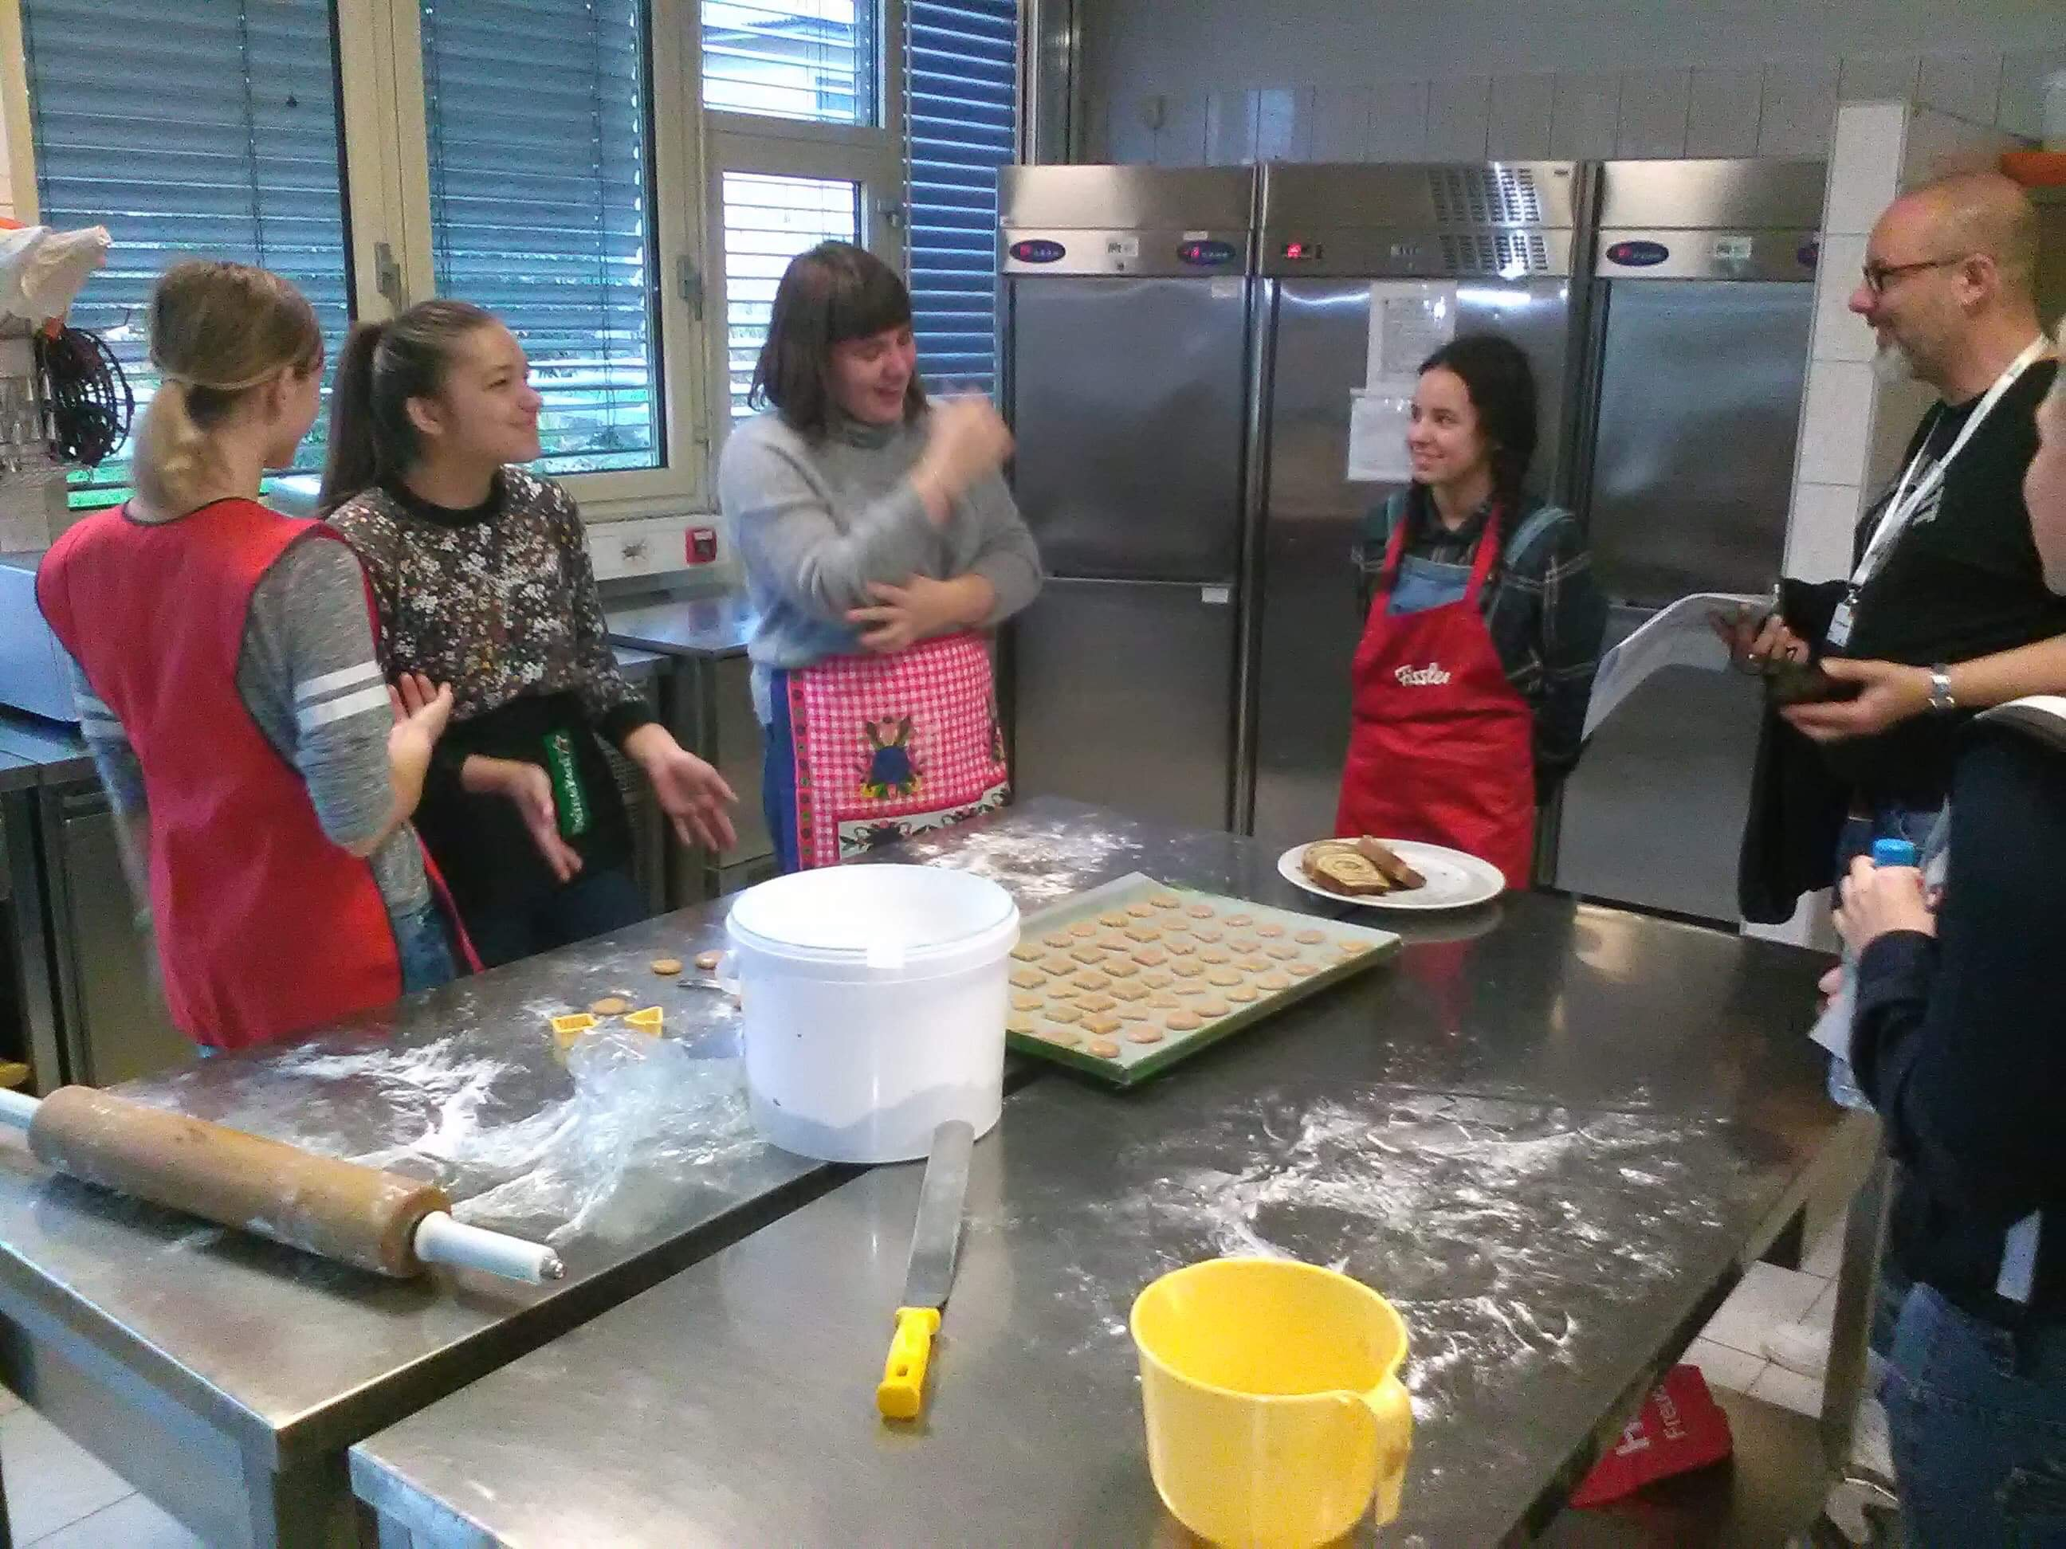
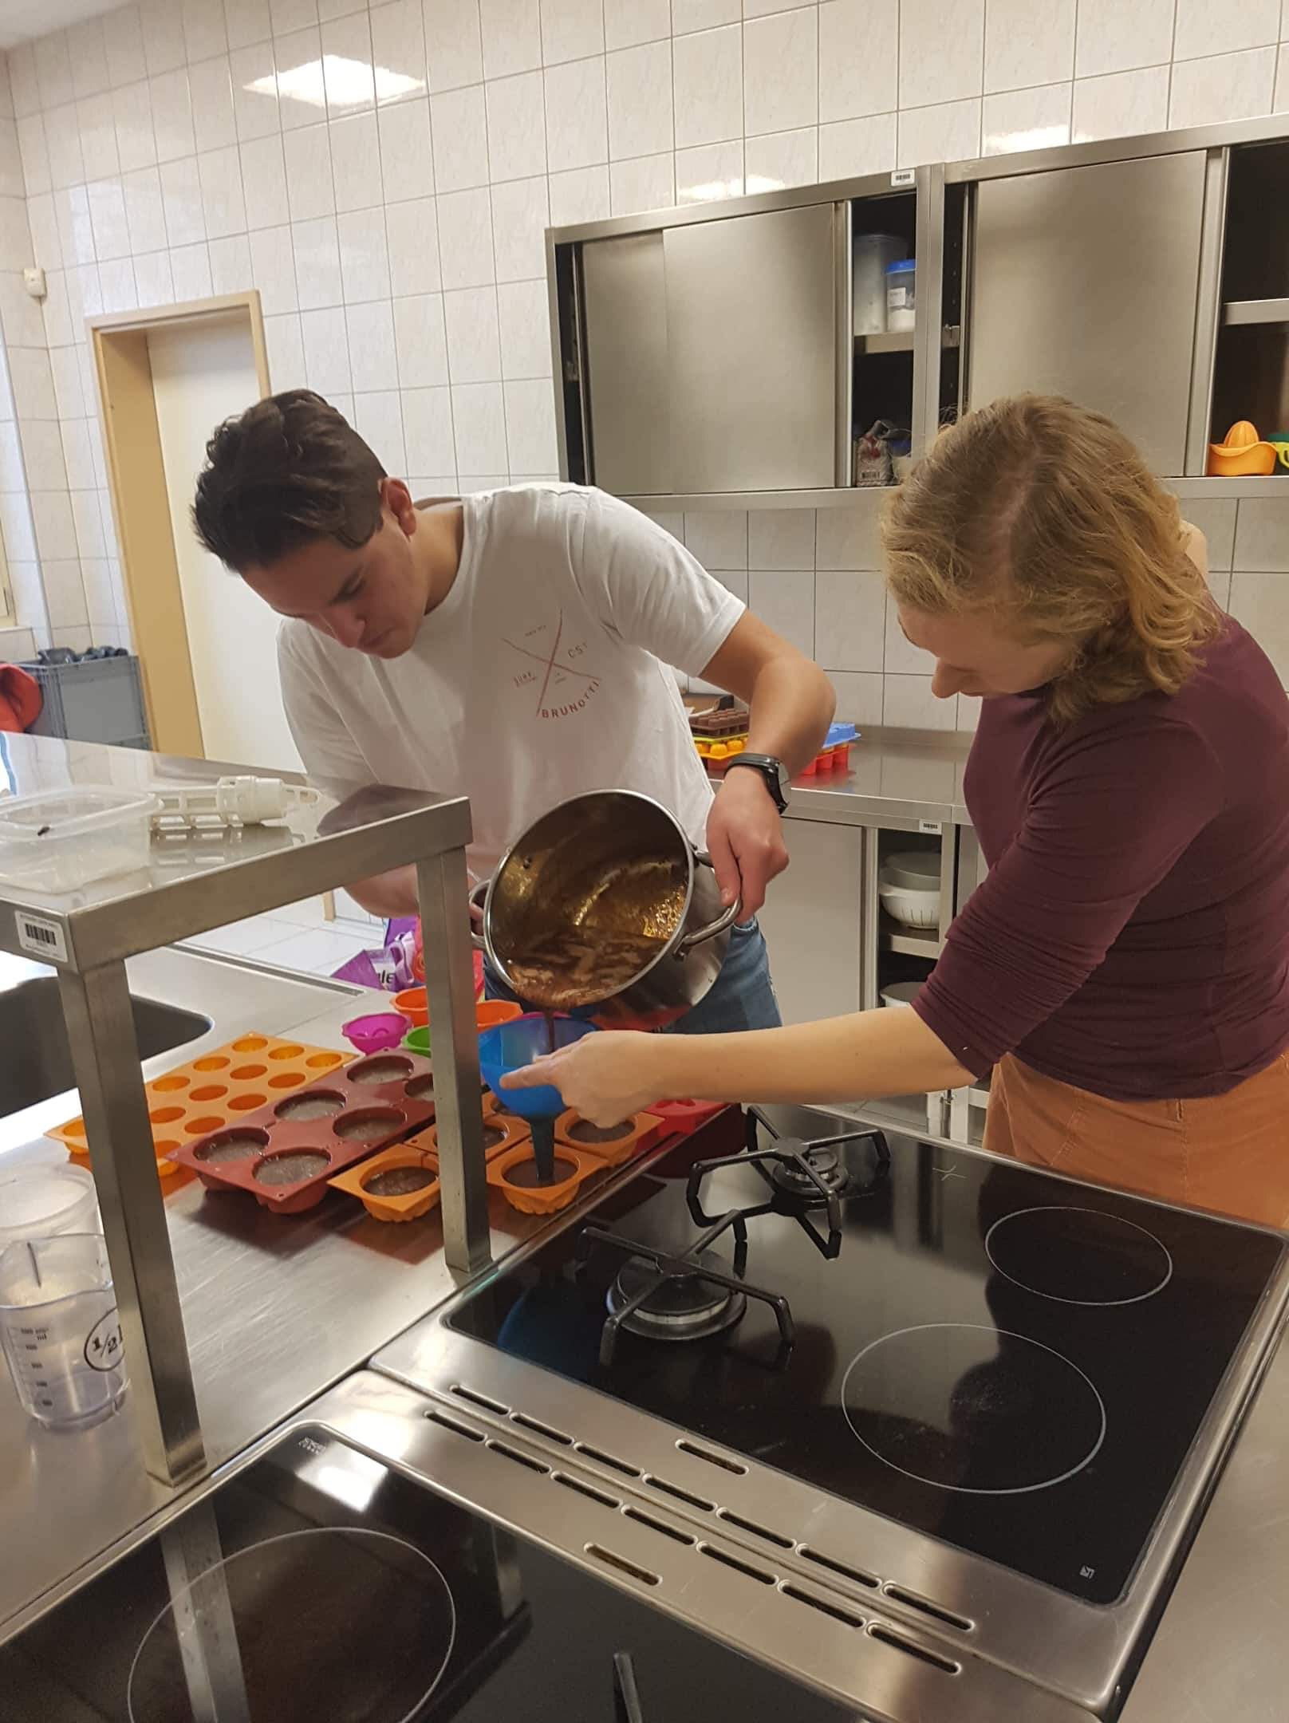
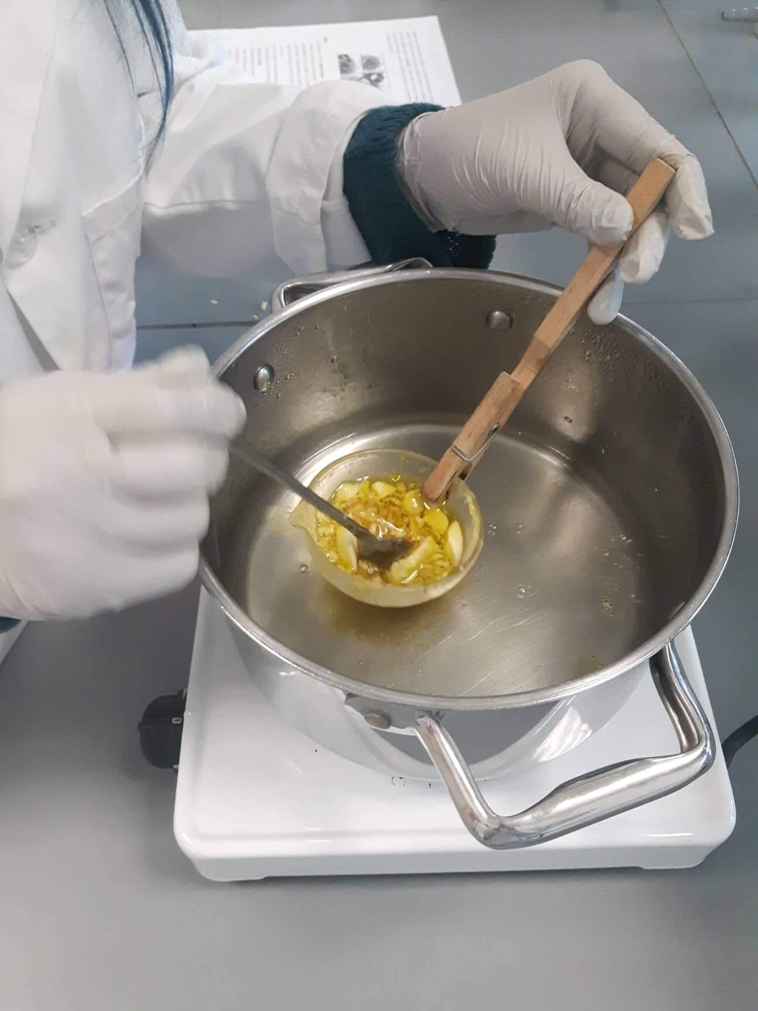
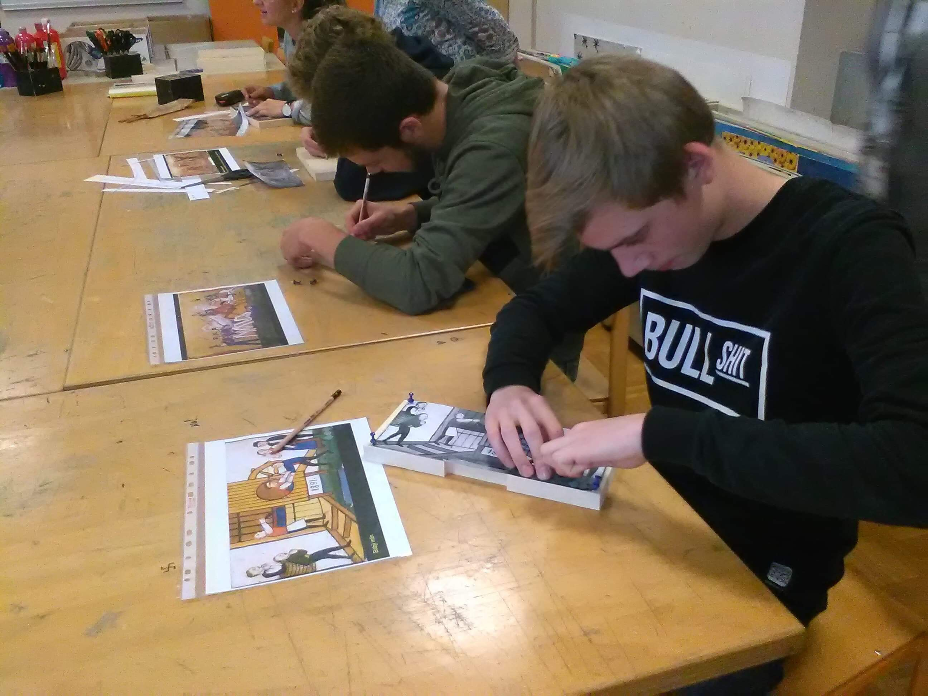
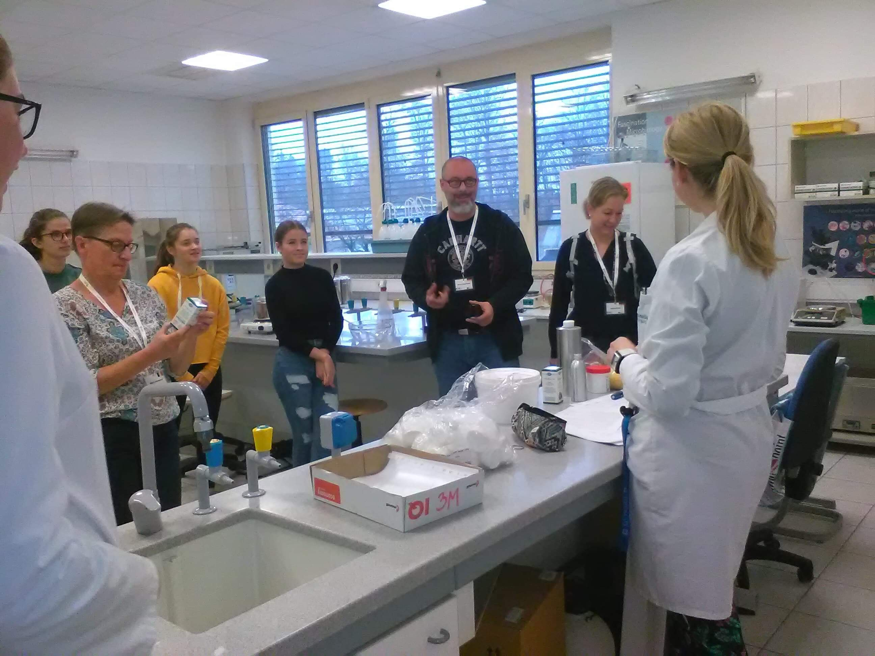
WEDNESDAY
We had workshops at BC Naklo school where we made creams, lipbalm, honey cookies, soap and we painted beehive panels.

Slide 5
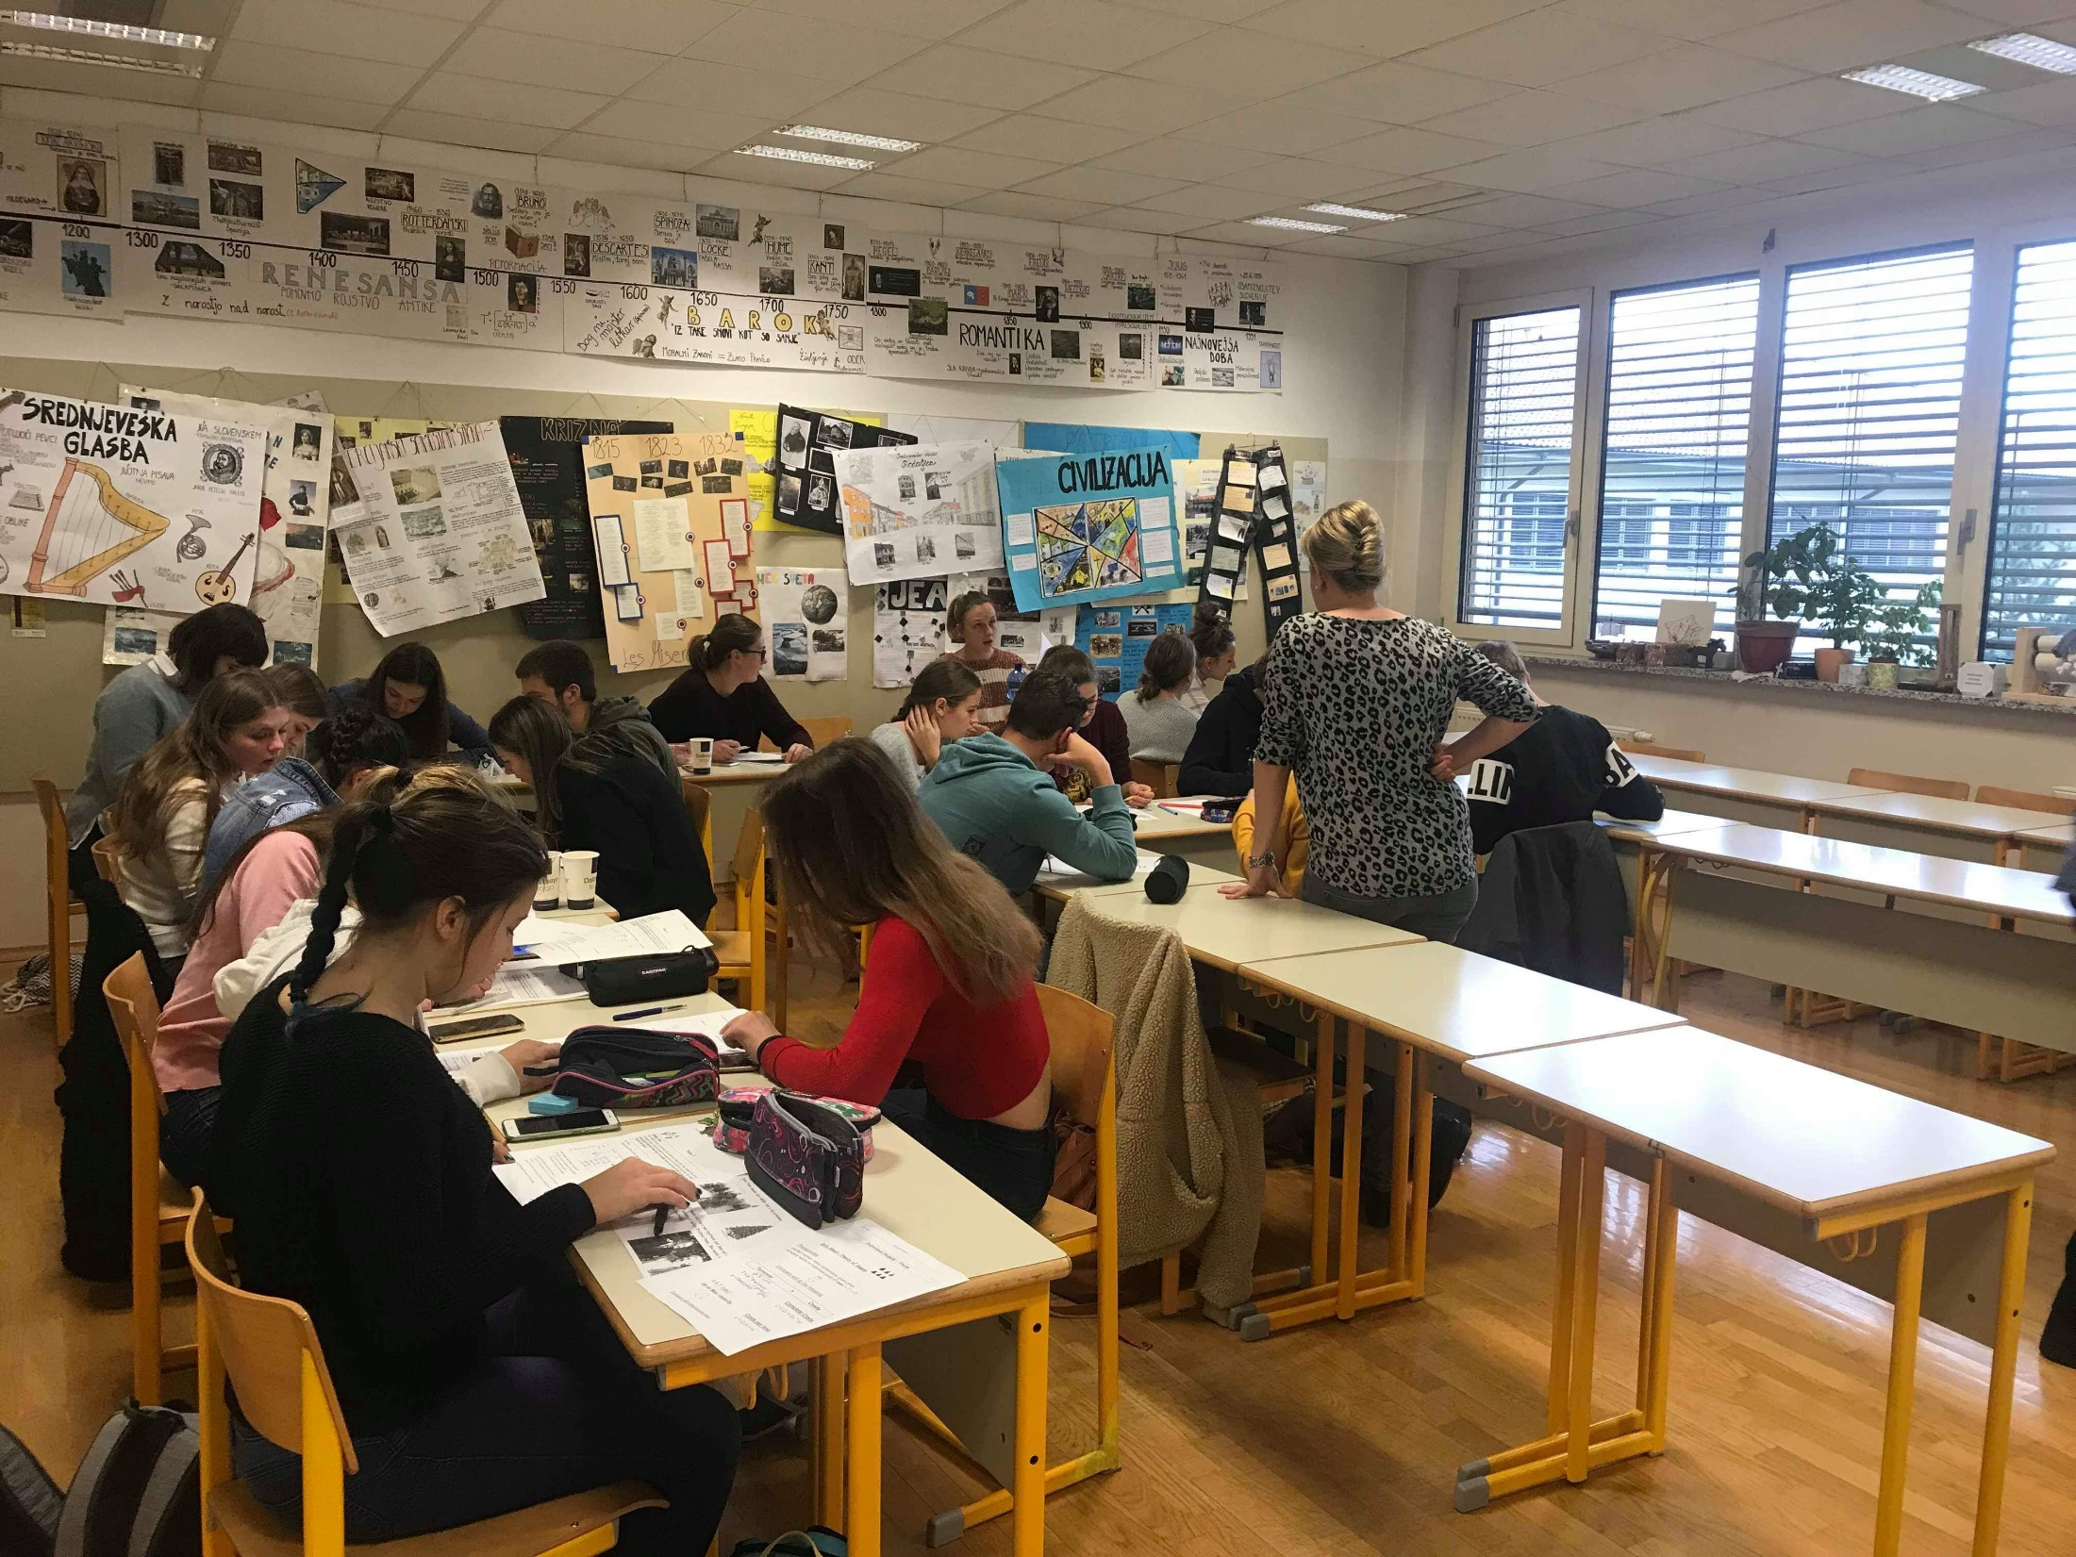
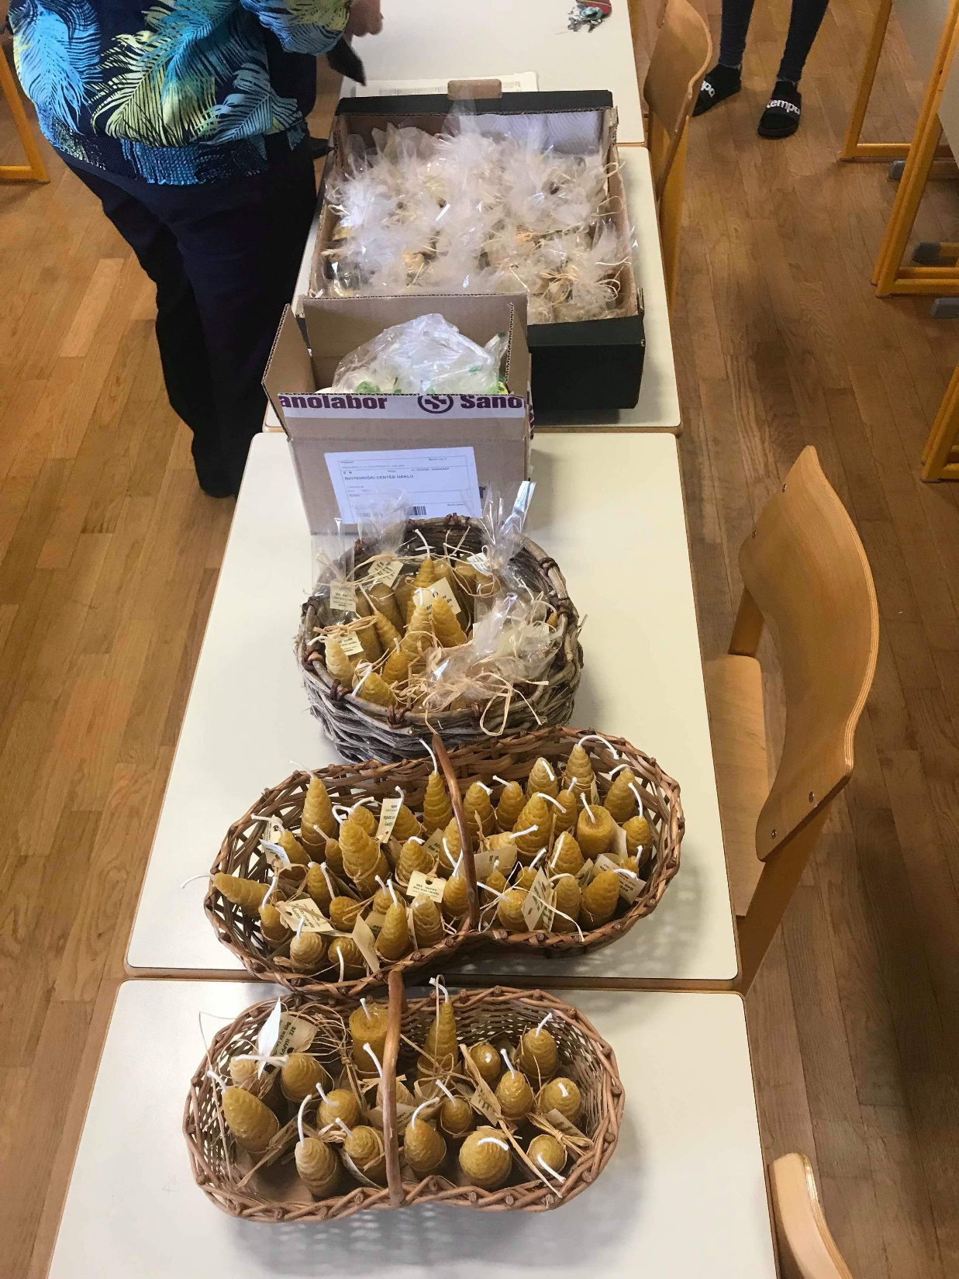
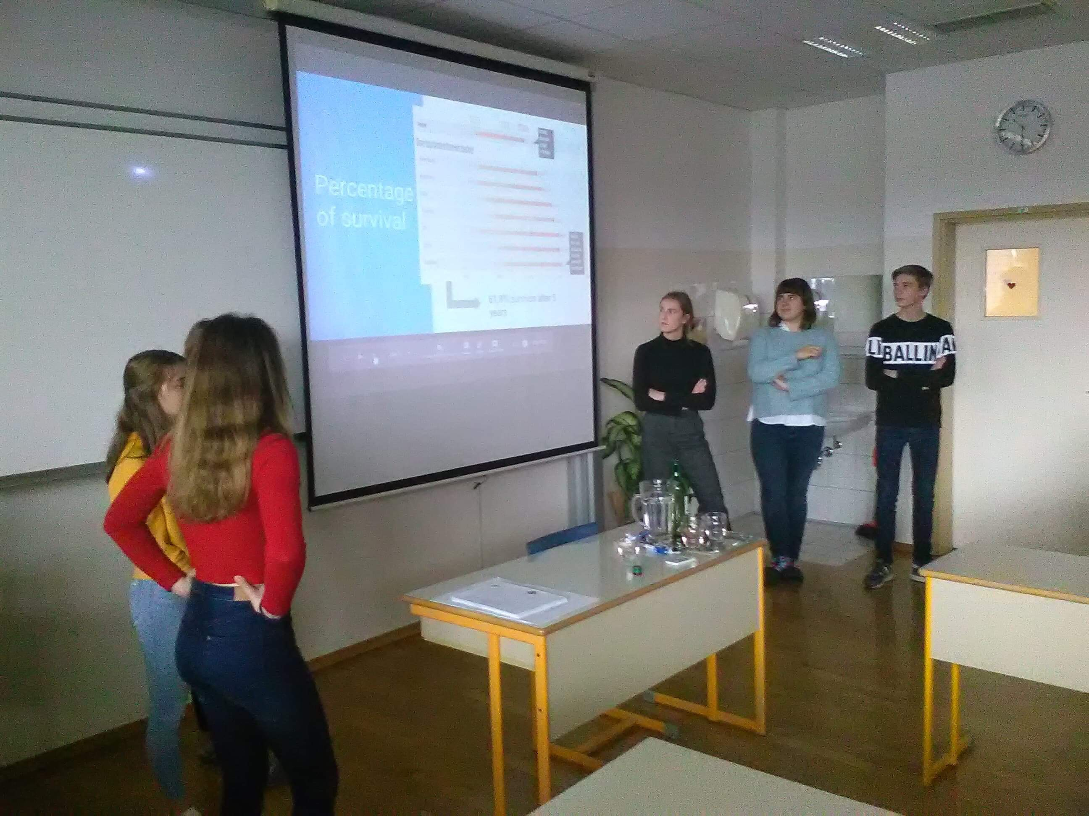
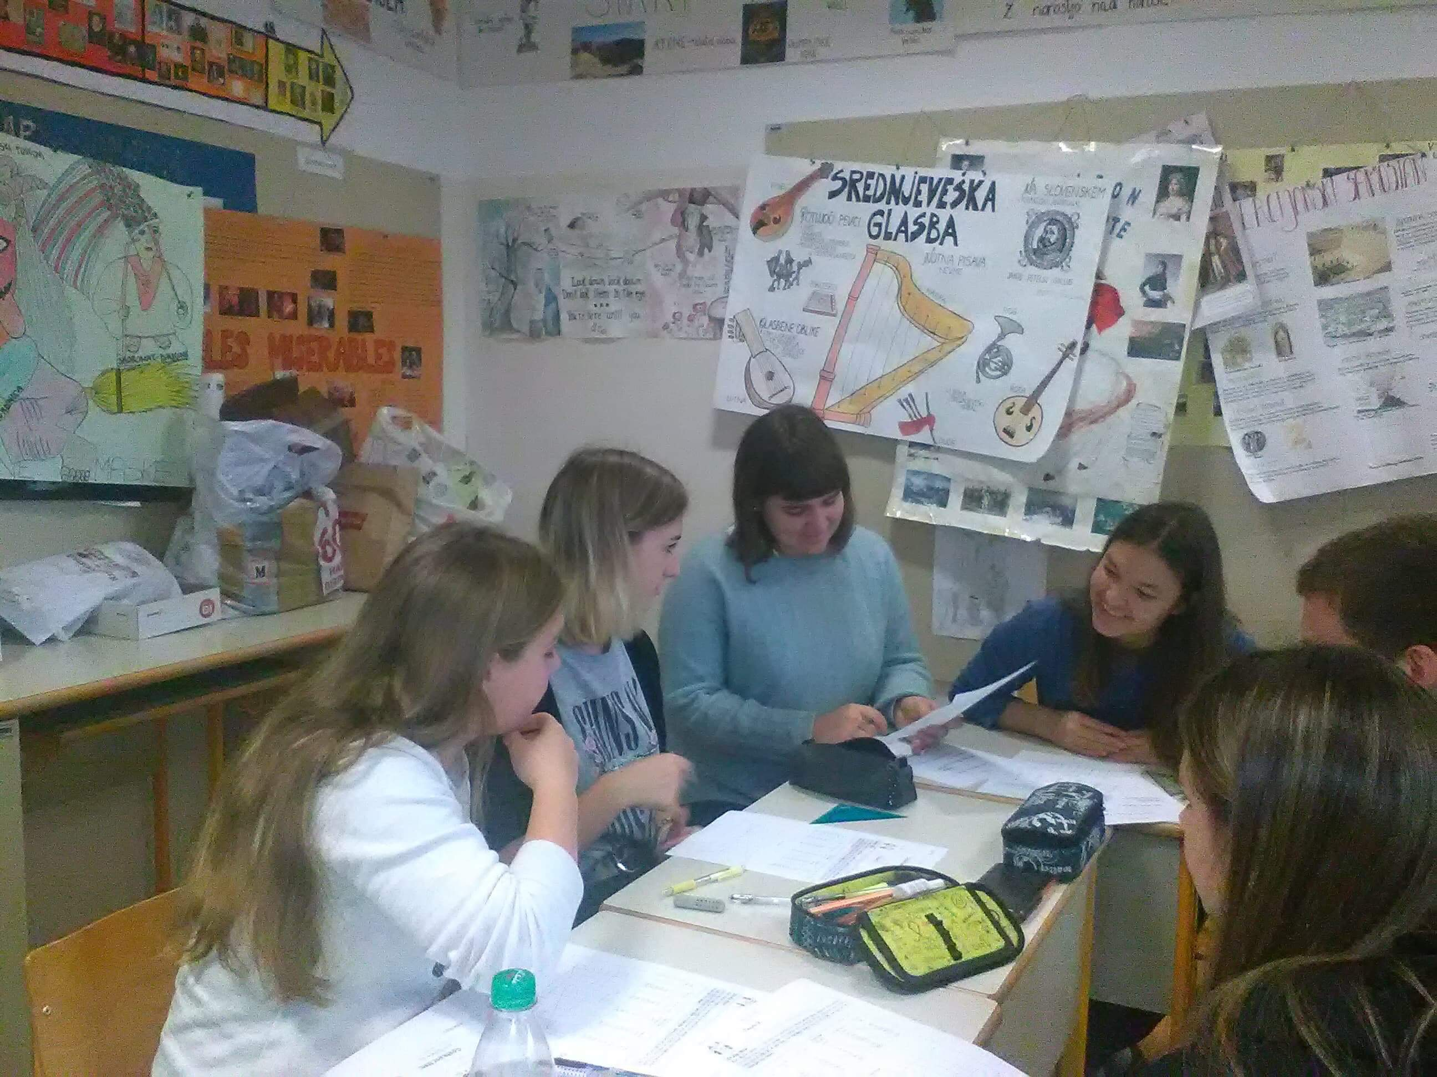
THURSDAY
We spent learning how to give a product the right price and making sure our products from the previous day were packed and prepared for sale.

Slide 6
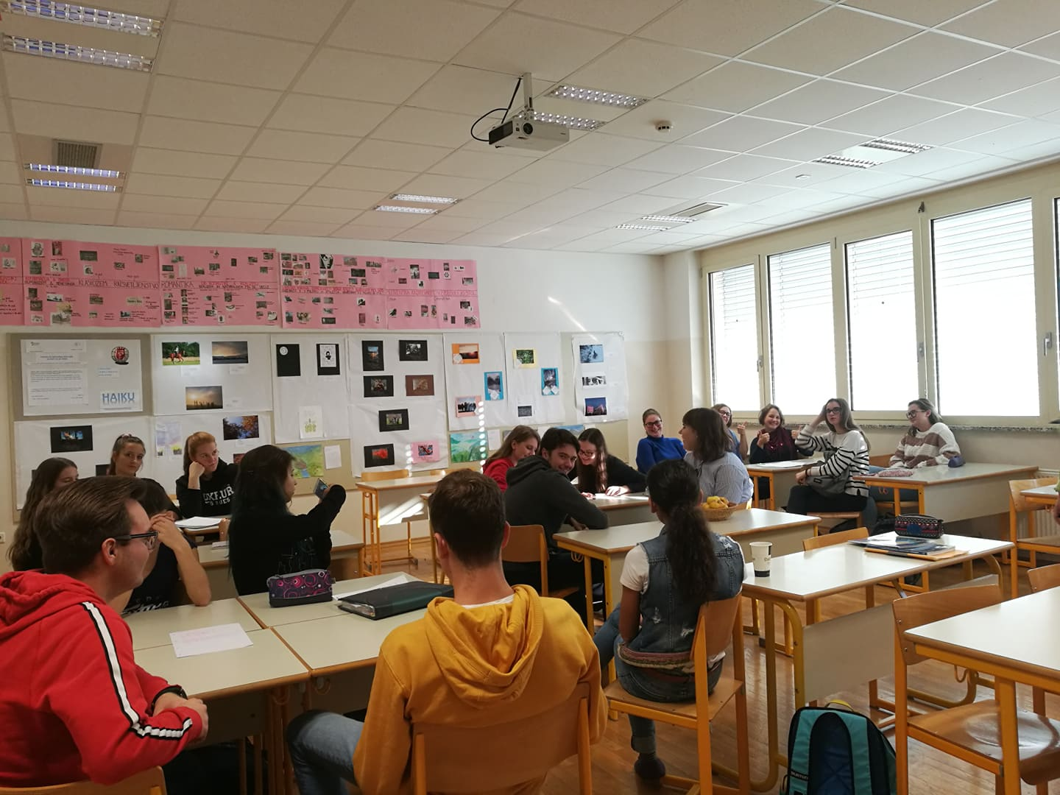
FRIDAY
The Belgian and German students spent the day in classes with us.

Slide 7
THANK YOU

